Slide 1



I3308 – Graduation Project
LEBANON F.A
GrassRoots Management System Site And Mobile Application
Préparé par :
-Hussein B. Fawaz.
-Abbas M. Sherkawi.
-Basel Reda.
Sous La direction du Dr. Bilal Kanso.

Slide 2
Content :
1. Introduction.
2. Data Base Architecture.
3. Intro To Admin Site.
4. Intro To Mobile App.
5. Upload news (News and Circulars-اخبار و تعاميم).
6. Open or download that circulars in the mobile app.
7. Add a future match in the admin site.
8. See the uploaded match .
9. Upload a result in the admin site.
10. See the uploaded result.
11. See the rank of the league.
12. Add a new team (academie) to the system or delete a team.
13. See all academies with the profile of each academie
14. Conclusion

Slide 3
1. Introduction
We developed a website and an app for the Lebanese Football Association, specifically for the GrassRoots (Academies).
The website allows admins to upload and manipulate data: news, results, matches…
A mobile application for Android and IOS to see all uploaded data
Classfication by districts (Beirut, South, …) and date-of-birth

Slide 4
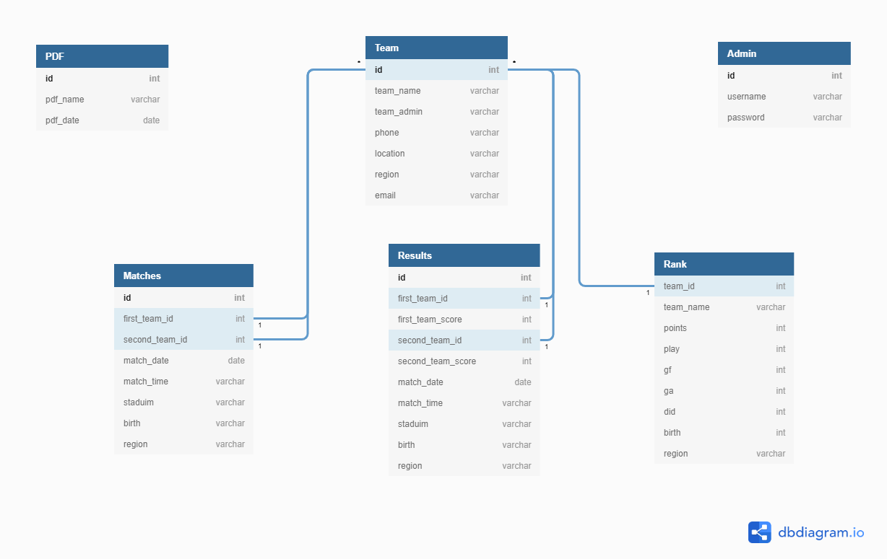
2. Database Architecture:

Slide 5
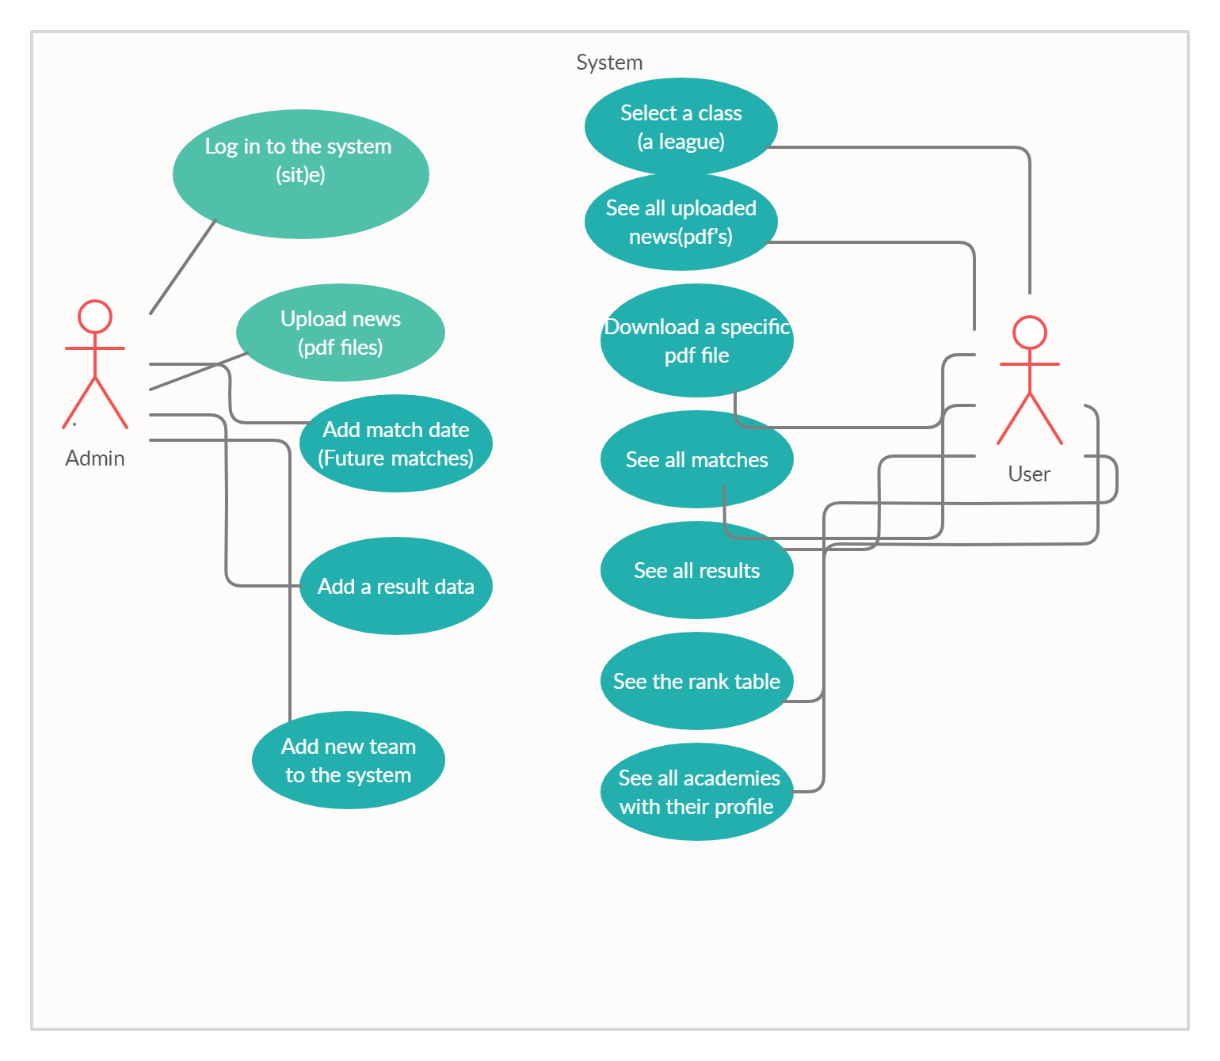
Use case diagram

Slide 6
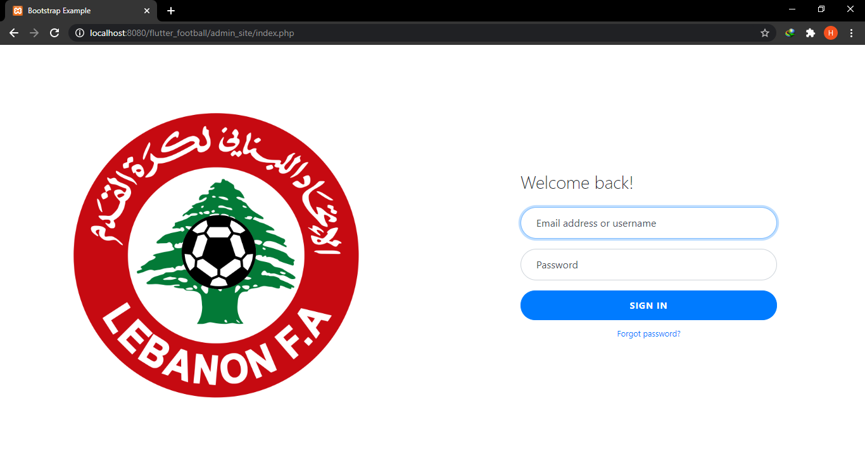
3. Introduction to the admin site
Website for the admin upload data
News and circulars as a pdf file.
Future matches.
Results.
Rank
Academies and their profiles.
To start, the admin must first login

Slide 7
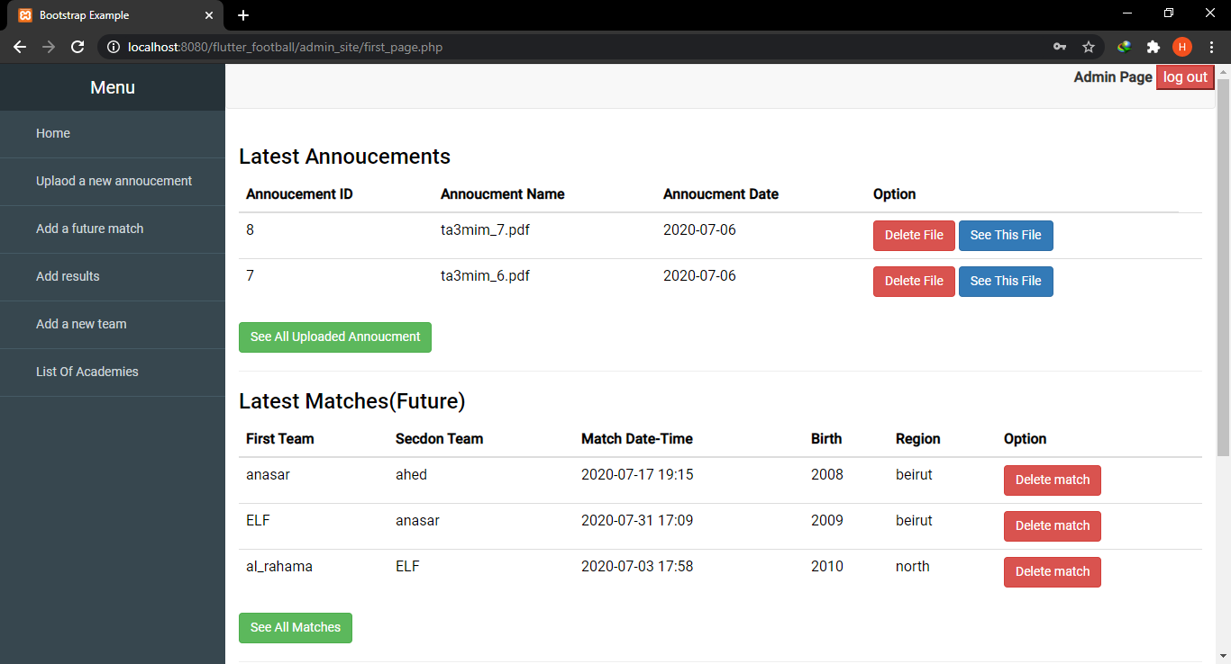
After logging in, the main page will contain the latest news (pdf files), results, future matches…
The admin can see and manipulate all pdf files, results, matches…
This page also contains a side navbar to navigate to different pages.

Slide 8

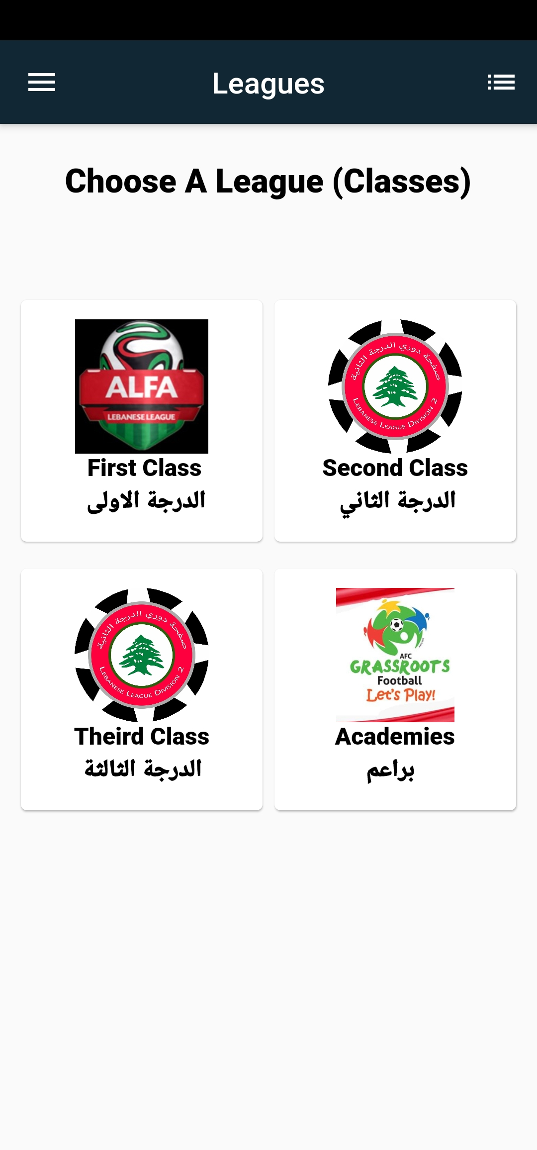
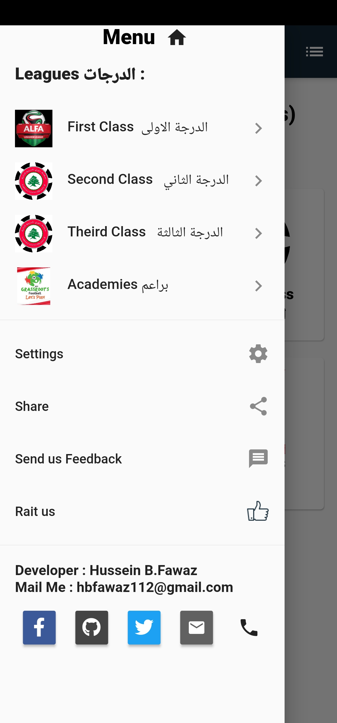
4. Introduction to mobile app
The app starts with a splash screen the LFA official logo. The main page contains buttons in grid form to navigate to special classes (leagues),
The First, second, and third classes are coming soon
Splash Screen
Select a class(league).
Left Drawer

Slide 9
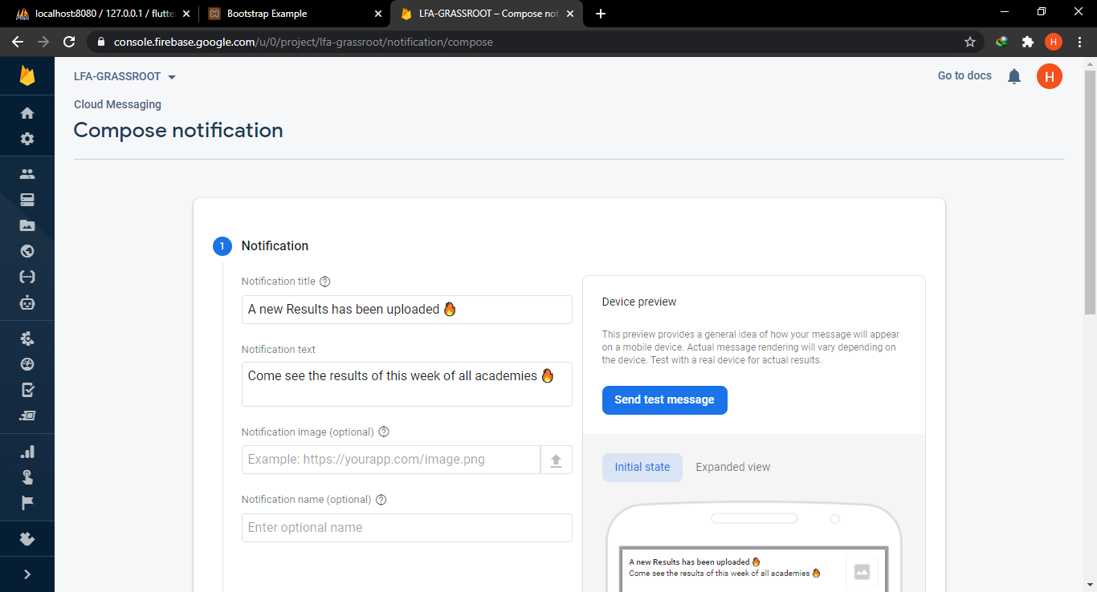
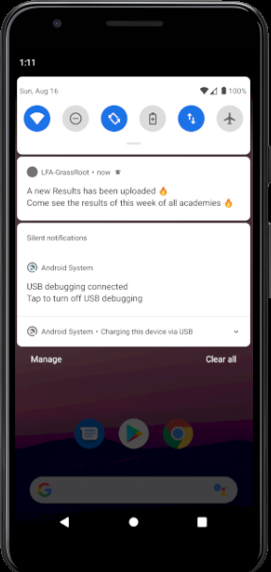
Connection With Fire Base:
Our App has been connected to firebase console to push a cloud messaging (notifications).
When the admin upload new data to system , he can go and push some notification to all user of the app.
Firebase console to push notifications
Notification arrived

Slide 10
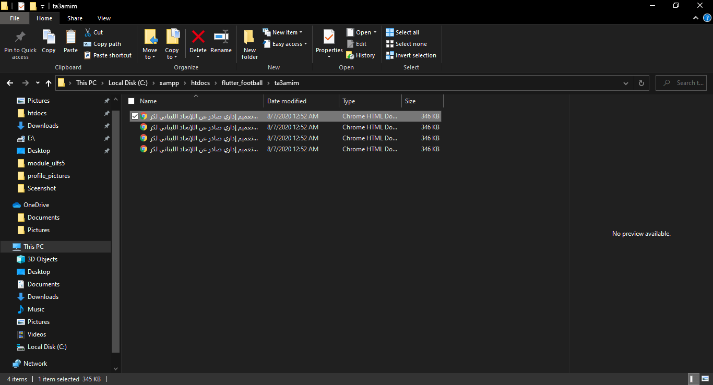
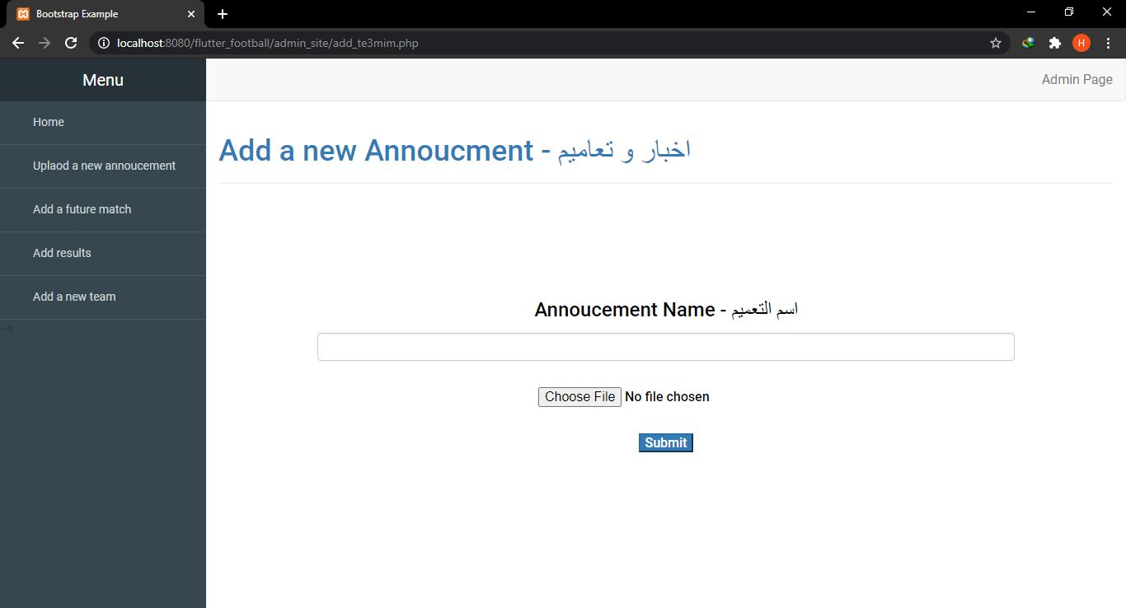
5. Upload news (PDF).
The admin can upload a new circular from the LFA as a pdf by selecting the pdf file and entering the name of the pdf. The file will be uploaded to the server
(in our case it will be a local host - htdocs folder)
The Uploaded files
The admin can access and manipulated all uploaded pdf files.
Upload a PDF file

Slide 11
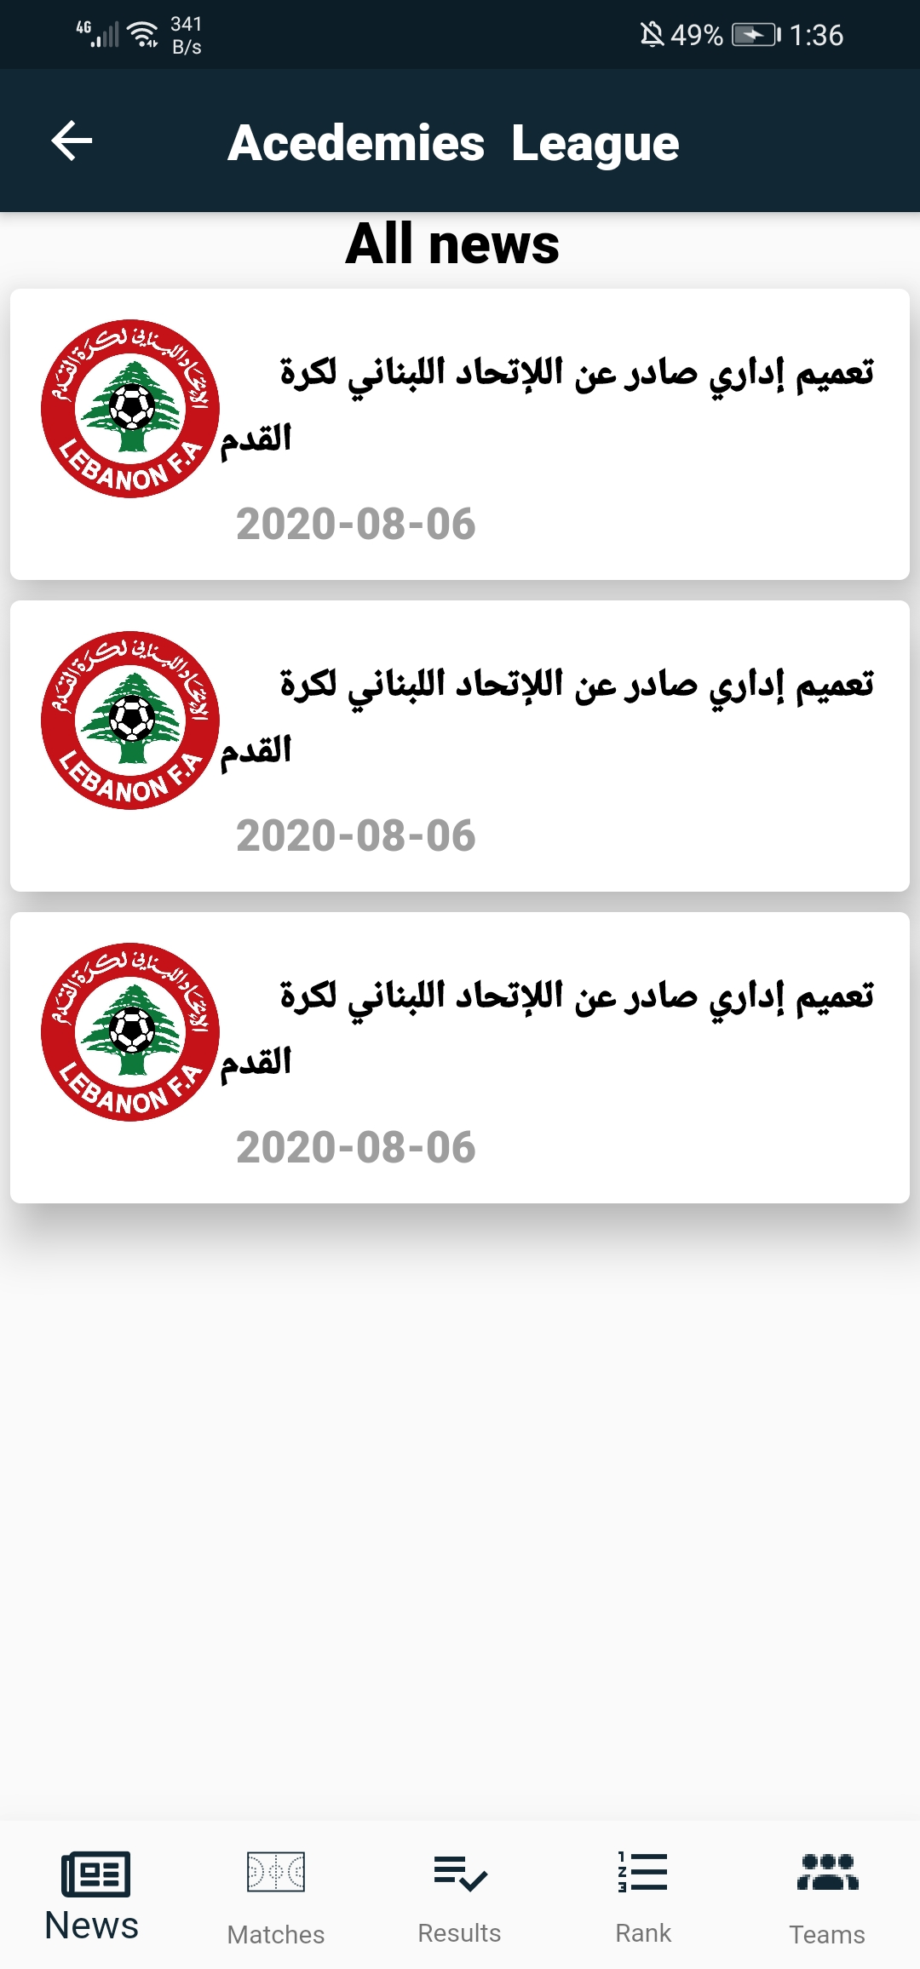
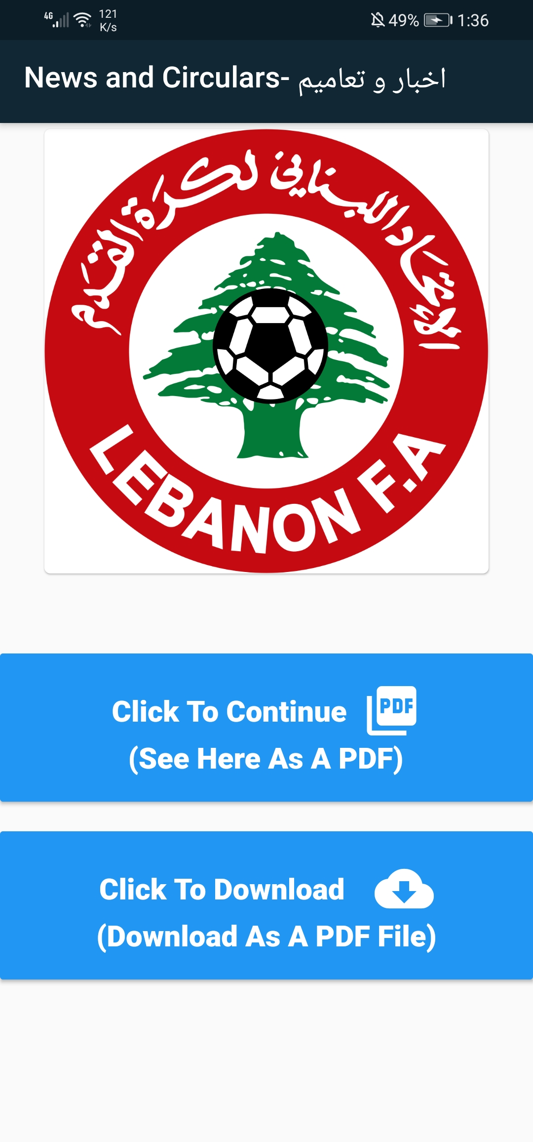
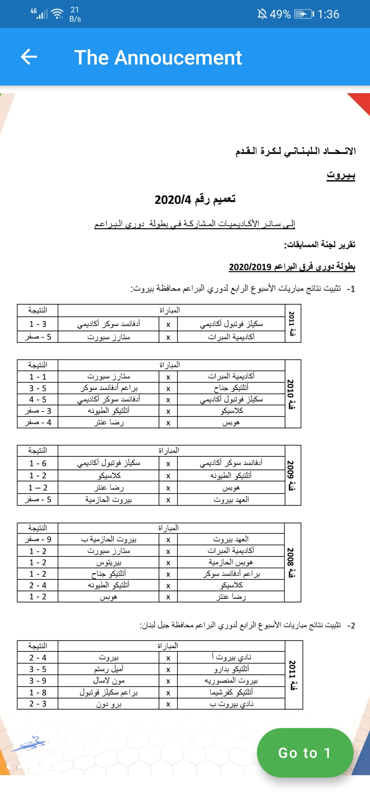
6. See or download the uploaded file (news pdf)
Users can see all the uploaded files by their name and their upload date
They can also access a specific file and see it directly in the app or download it as a pdf file to their mobile.
List Of Files
Choice of see or download
The PDF file on the app

Slide 12
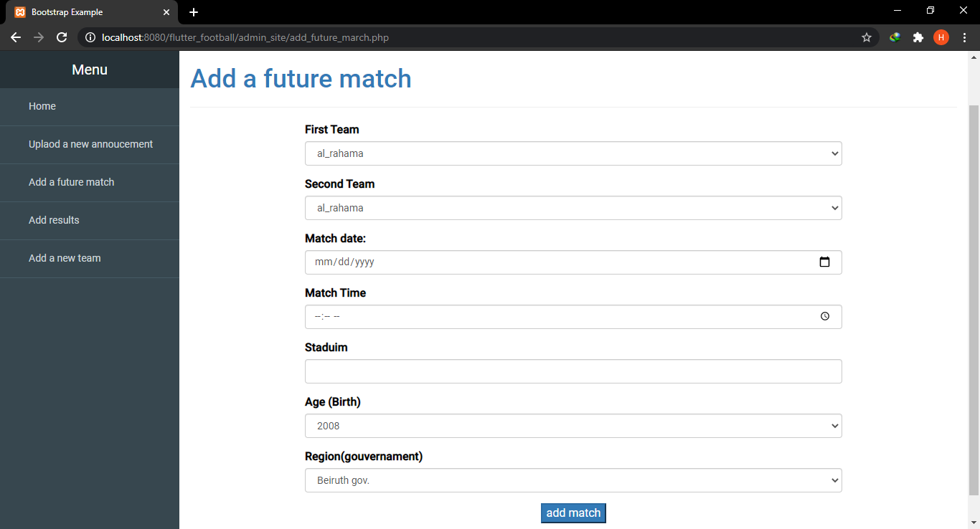
7. Add a future match (by the admin)
The admin can upload the data for a new or a future match
The two teams participating in the match.
Date and time.
Stadium.
Region and date-of-birth.
It’s a simple form with 2 drop down menus containing all academies from the system to choose the 2 team for the match and input fields for date and time.
Also the admin can access and manipulate all uploaded matches

Slide 13
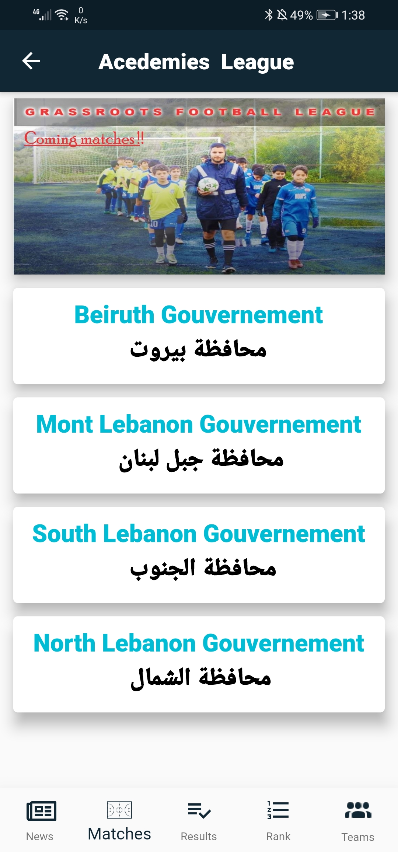
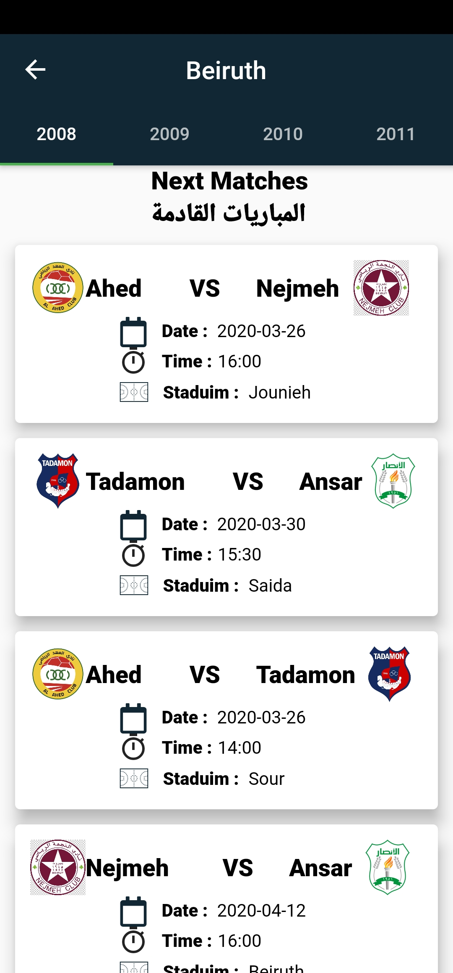
8. See the uploaded match from the app.
The user must first choose the region and then a view pager to swipe between the date of births (2008-2009-2010-2011).

Slide 14
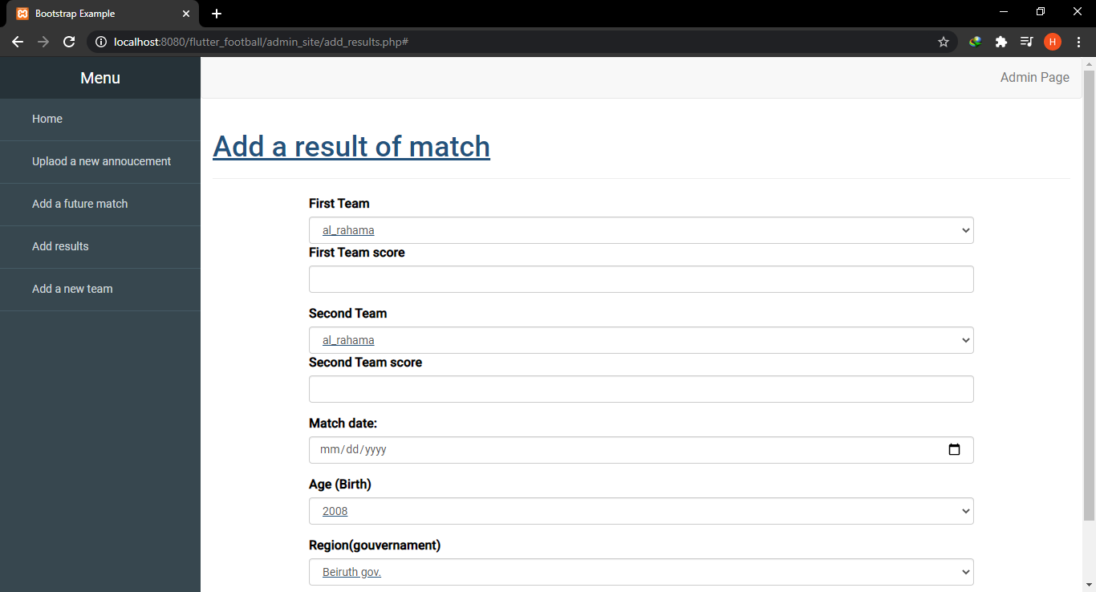
9. Add a result (by the admin)
The admin can upload the data for new results
The two teams participating in the match and their scores
Match date and time.
Stadium.
Region and Birth.
It’s a simple form with 2 drop down menus containing all academies to choose the 2 teams for the match and input fields for scores, and date and time.
NB: The rank will be updated automatically based on the result (+3 in case of winning and +1 In case of a draw , etc.…).
Also the admin can access and manipulate all uploaded results

Slide 15
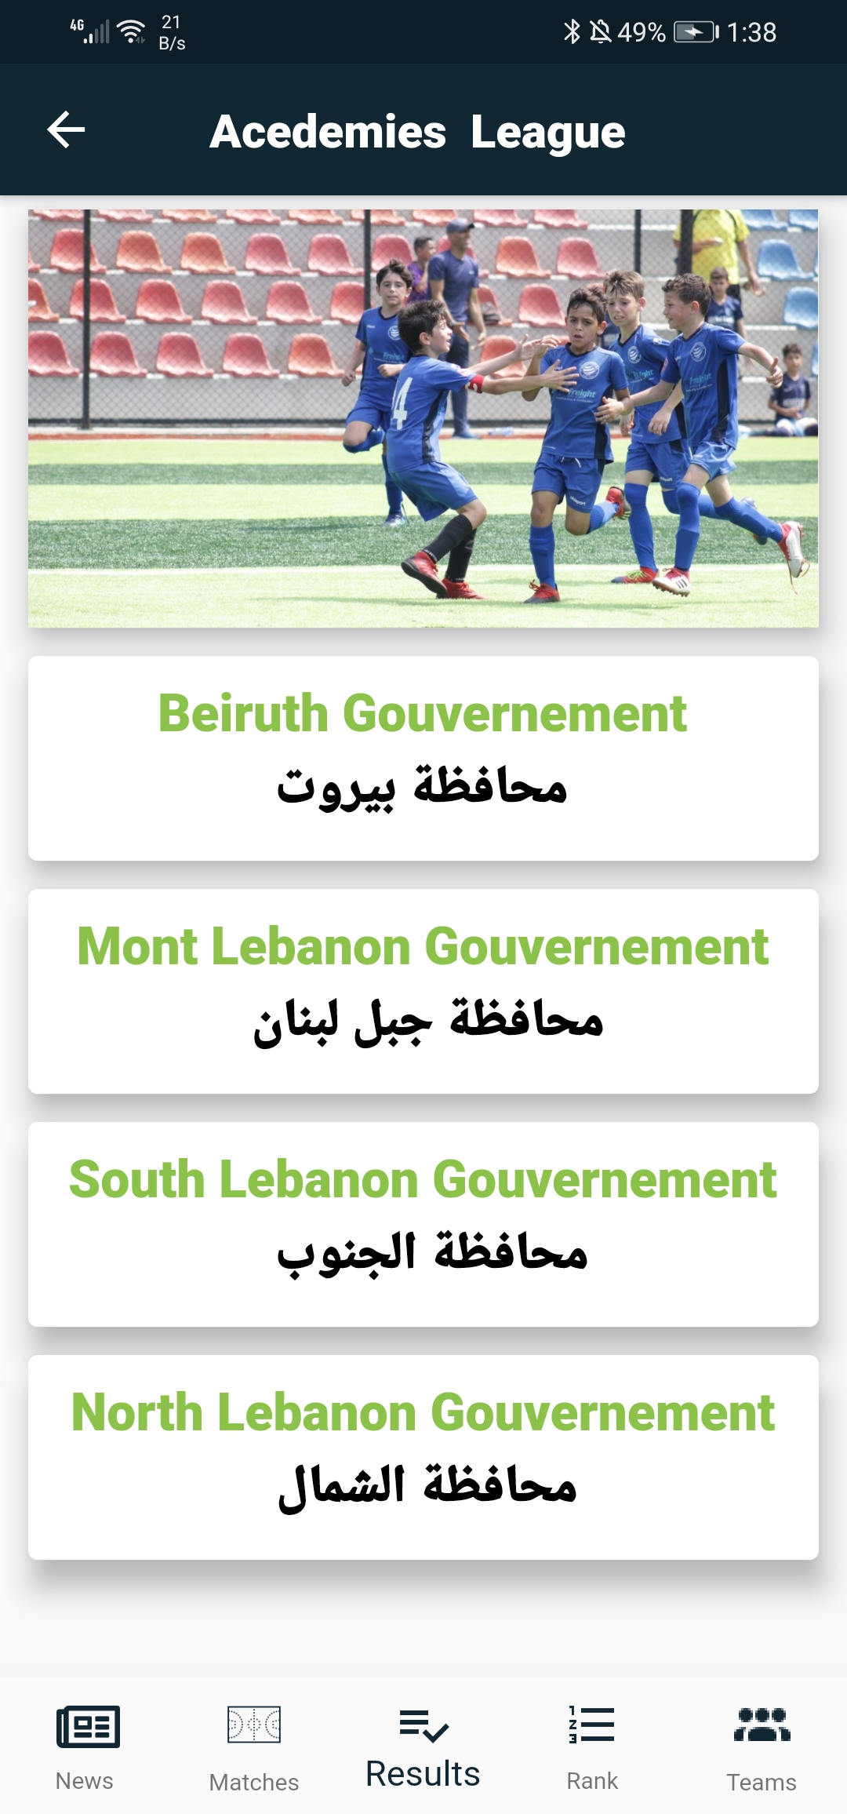
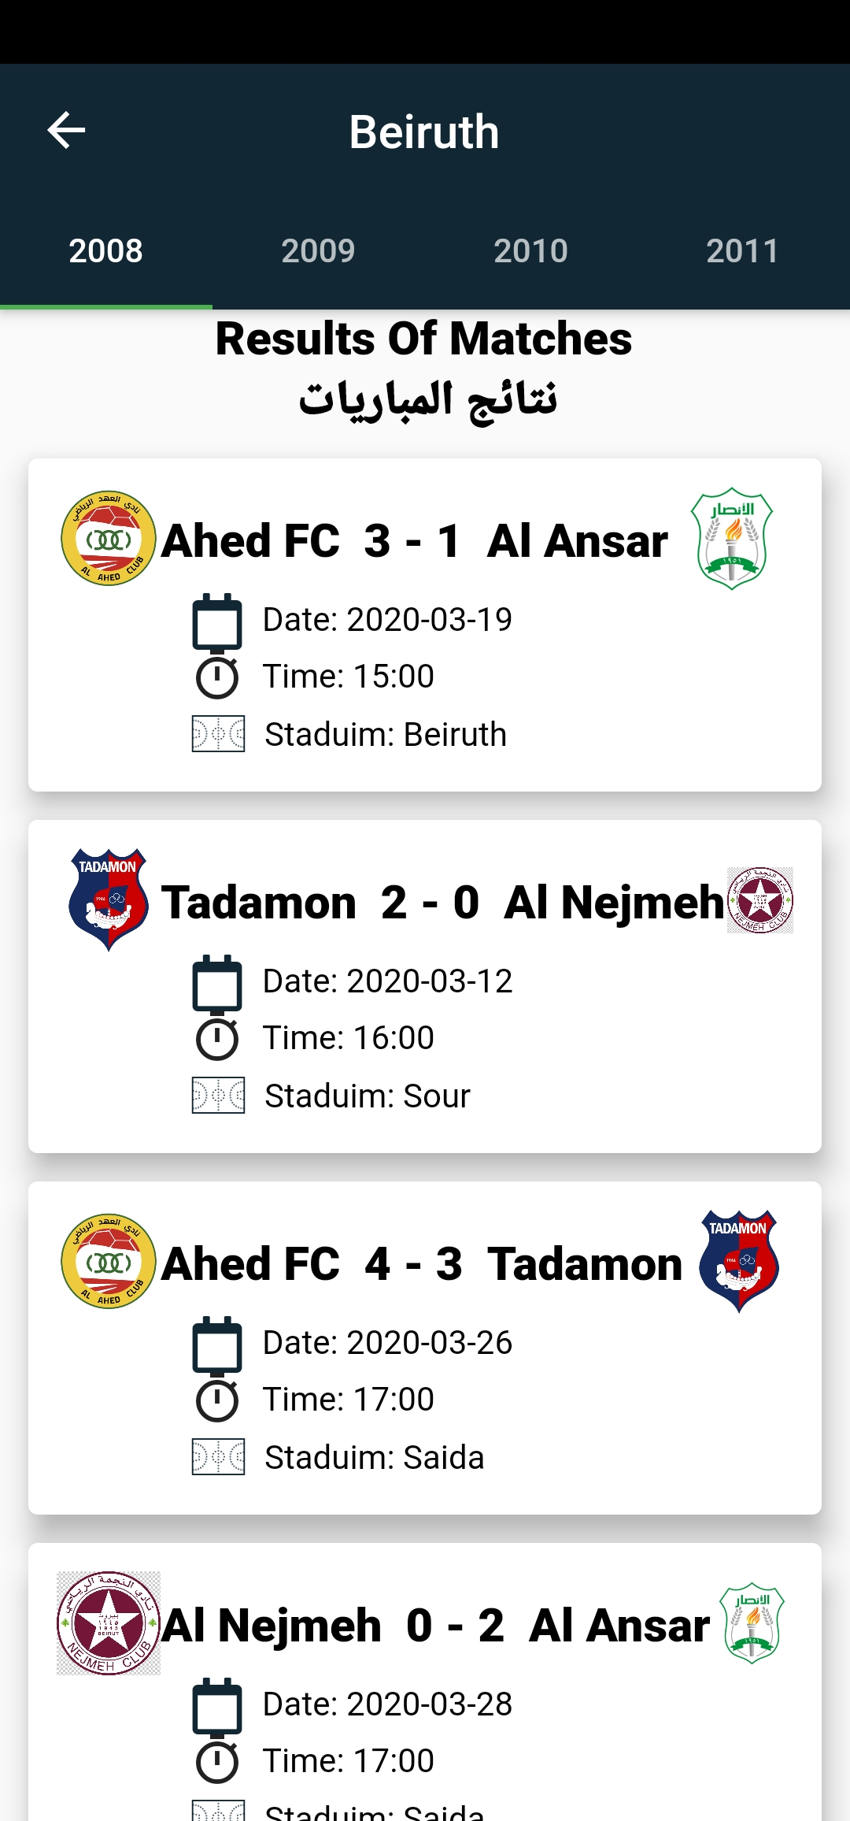
10. See the uploaded results from the app.
The user must first choose the region and then a view pager to swipe between date of births (2008-2009-2010-2011).

Slide 16
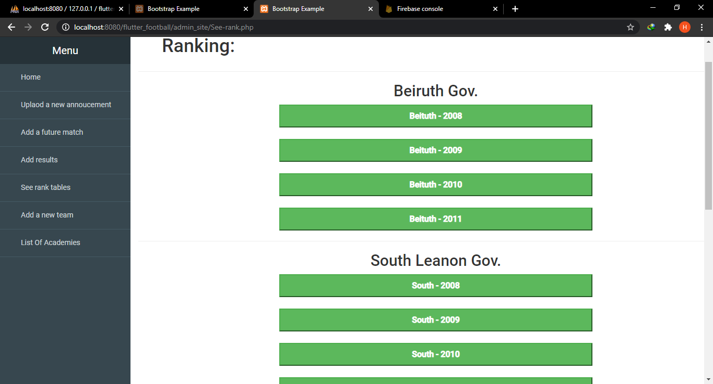
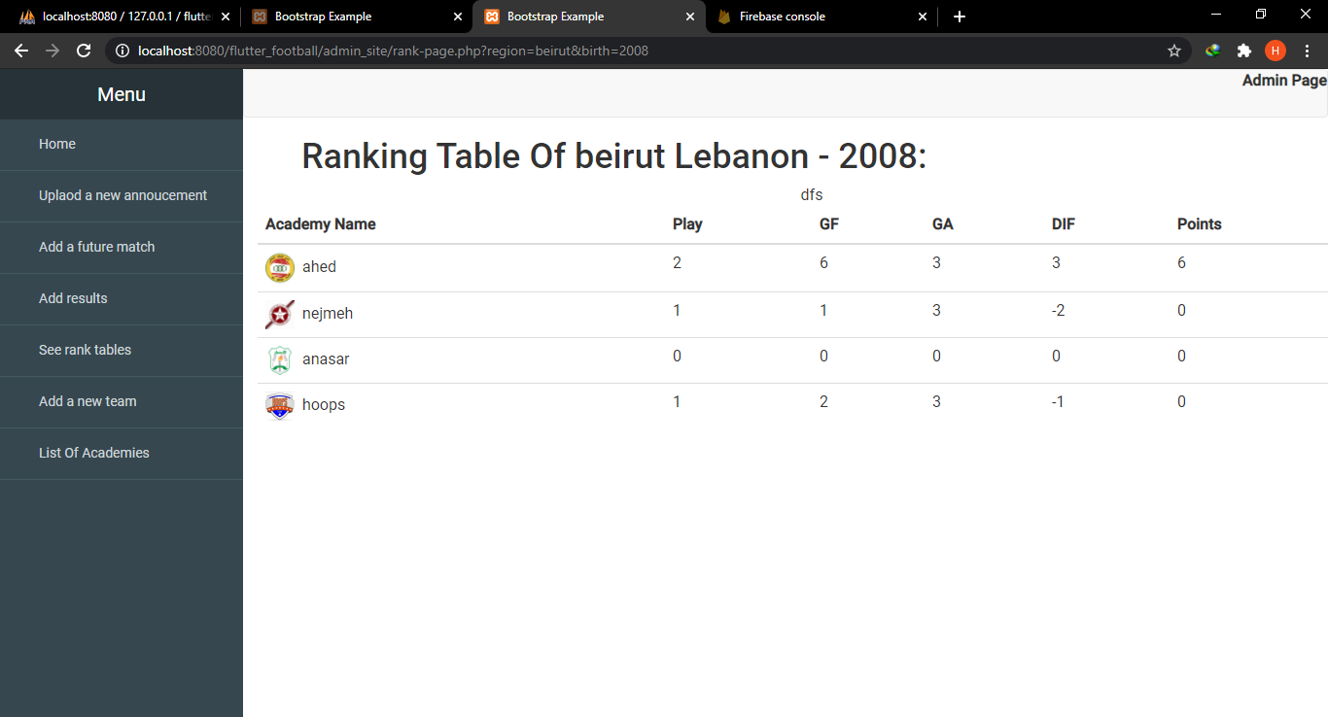
Ranking Page :
The admin first select which districts and which date of birth,then a ranking table show up base on the results.

Slide 17
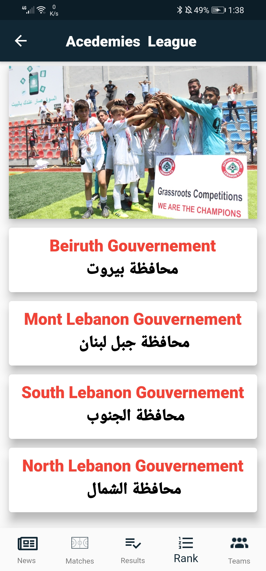
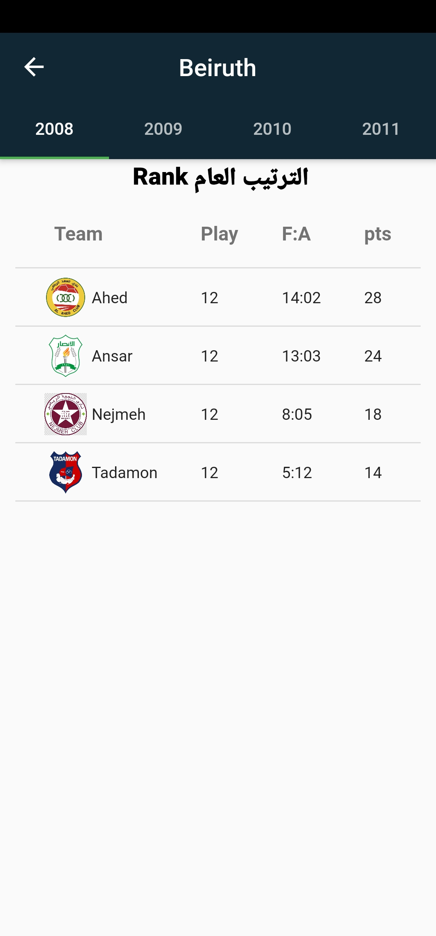
11. See the rank table from the app.
The user must first choose the region and then a view pager to swipe between the date births (2008-2009-2010-2011).
Each age with a government has its own rank table (16 rank tables in total).

Slide 18
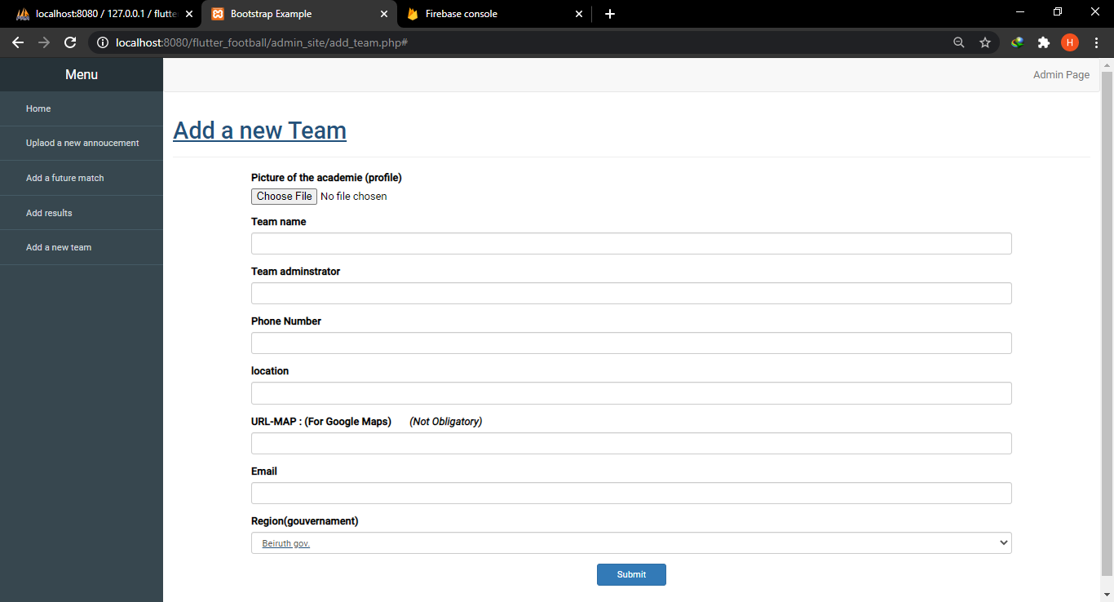
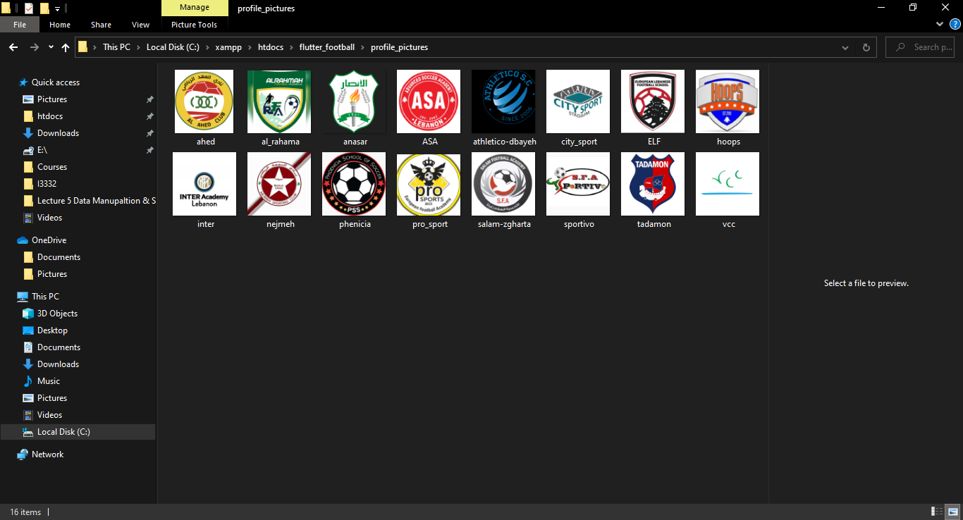
12. Add a new team (academy) to the system or delete a team.
The admin can go and add a new team (academy) to the system by choosing a profile picture that will be uploaded to the local host server and some other informations related to the team (region, name, phone number, etc.…)
Profile pictures upload to the server.

Slide 19
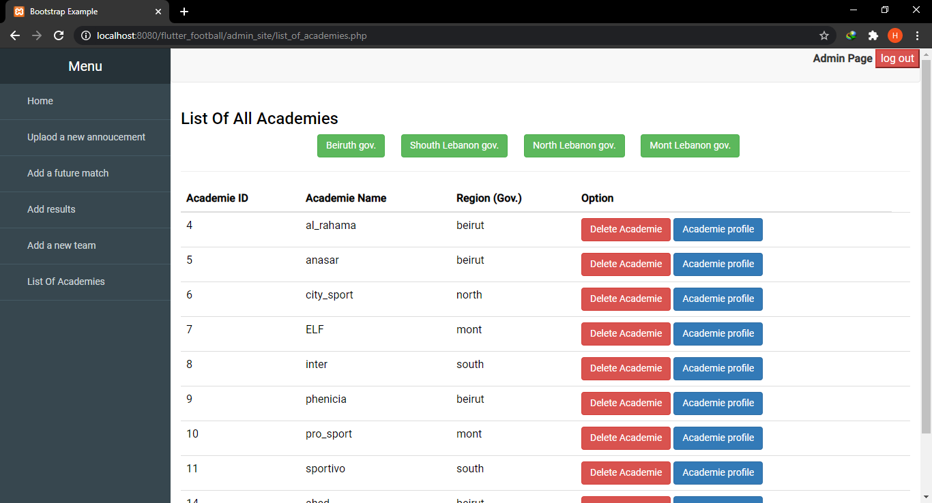
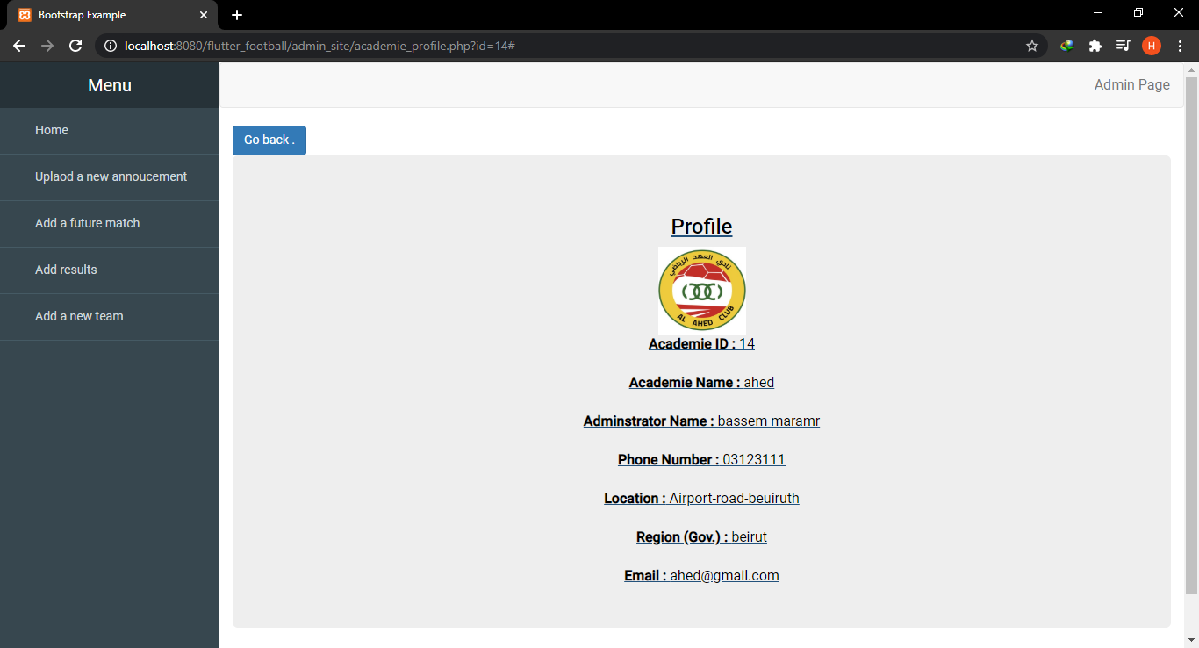
List Of Academies (Seen by the admin)
The admin can see and manipulate all the academies in the system and their profiles.
The admin can also filter by region to see all academies in it
List of academies with choice of region
Profile of a team selected

Slide 20
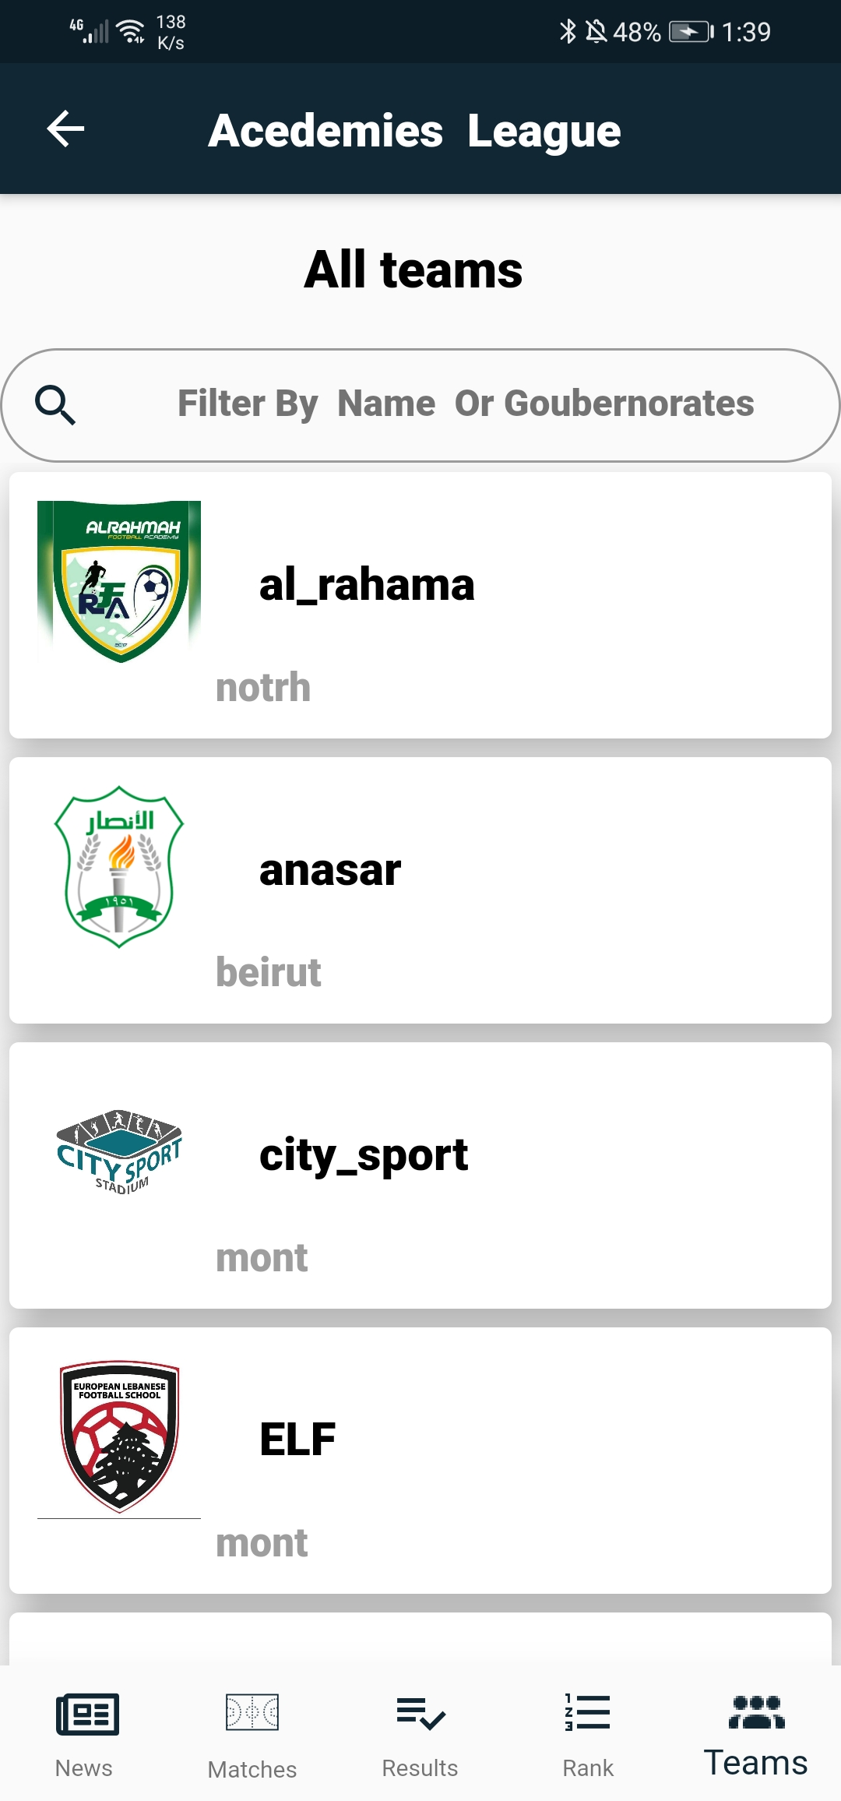
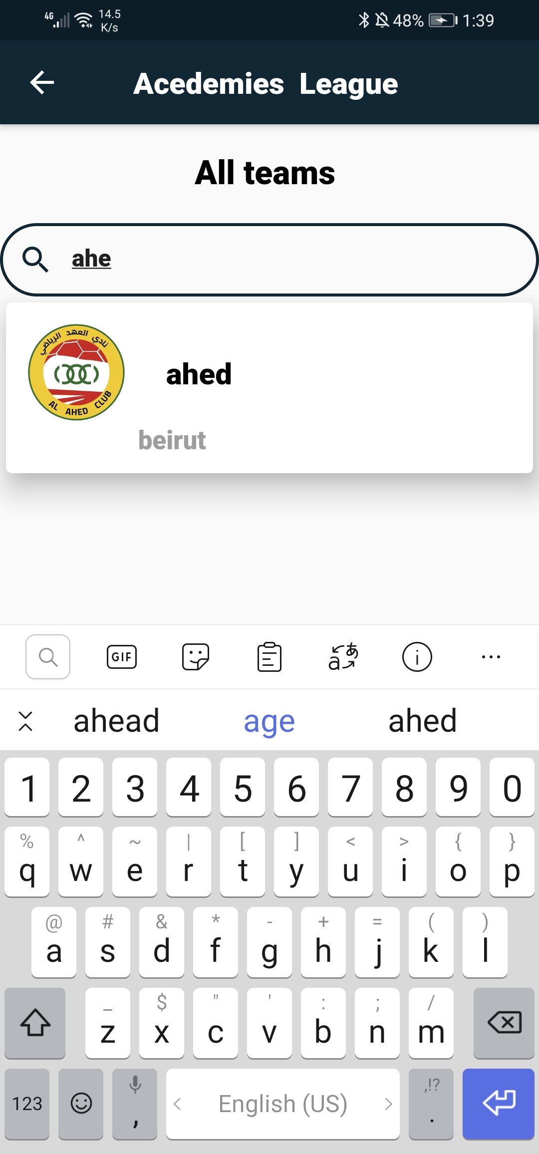
13. See all academies.
List of all academies
Search bar to search for a team

Slide 21
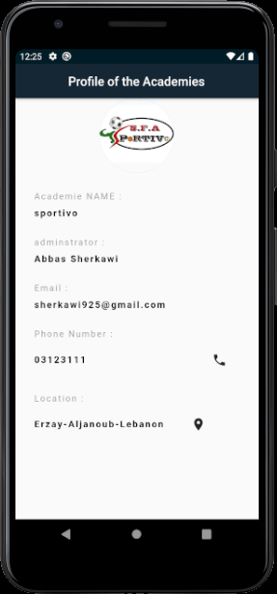
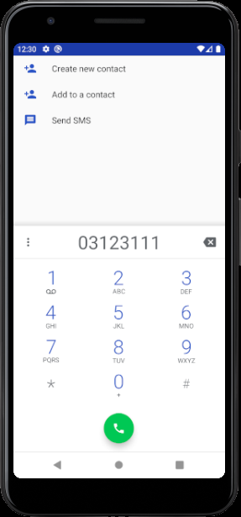
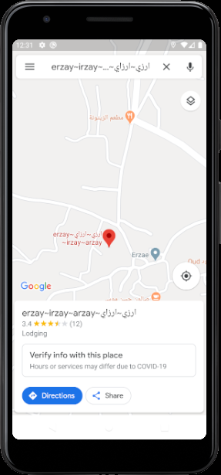
Profile Of the academy with some options:
The User can click on call icon button and it will automatically call this number , and he can also click on the location icon button and he will open to google maps to see the location .
Profile of a selected academy.
Google Maps of the location.
Phone Call .

Slide 22
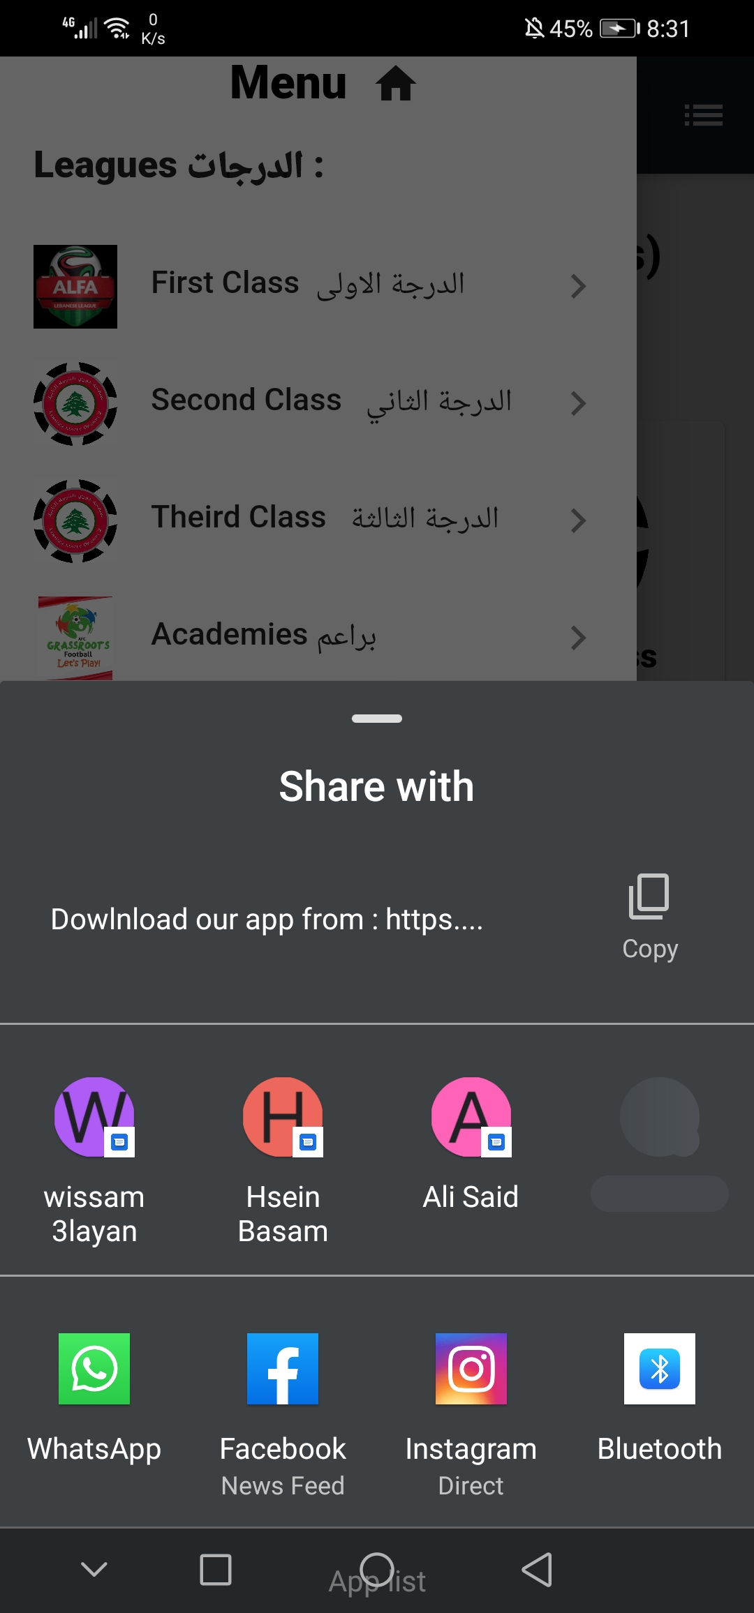
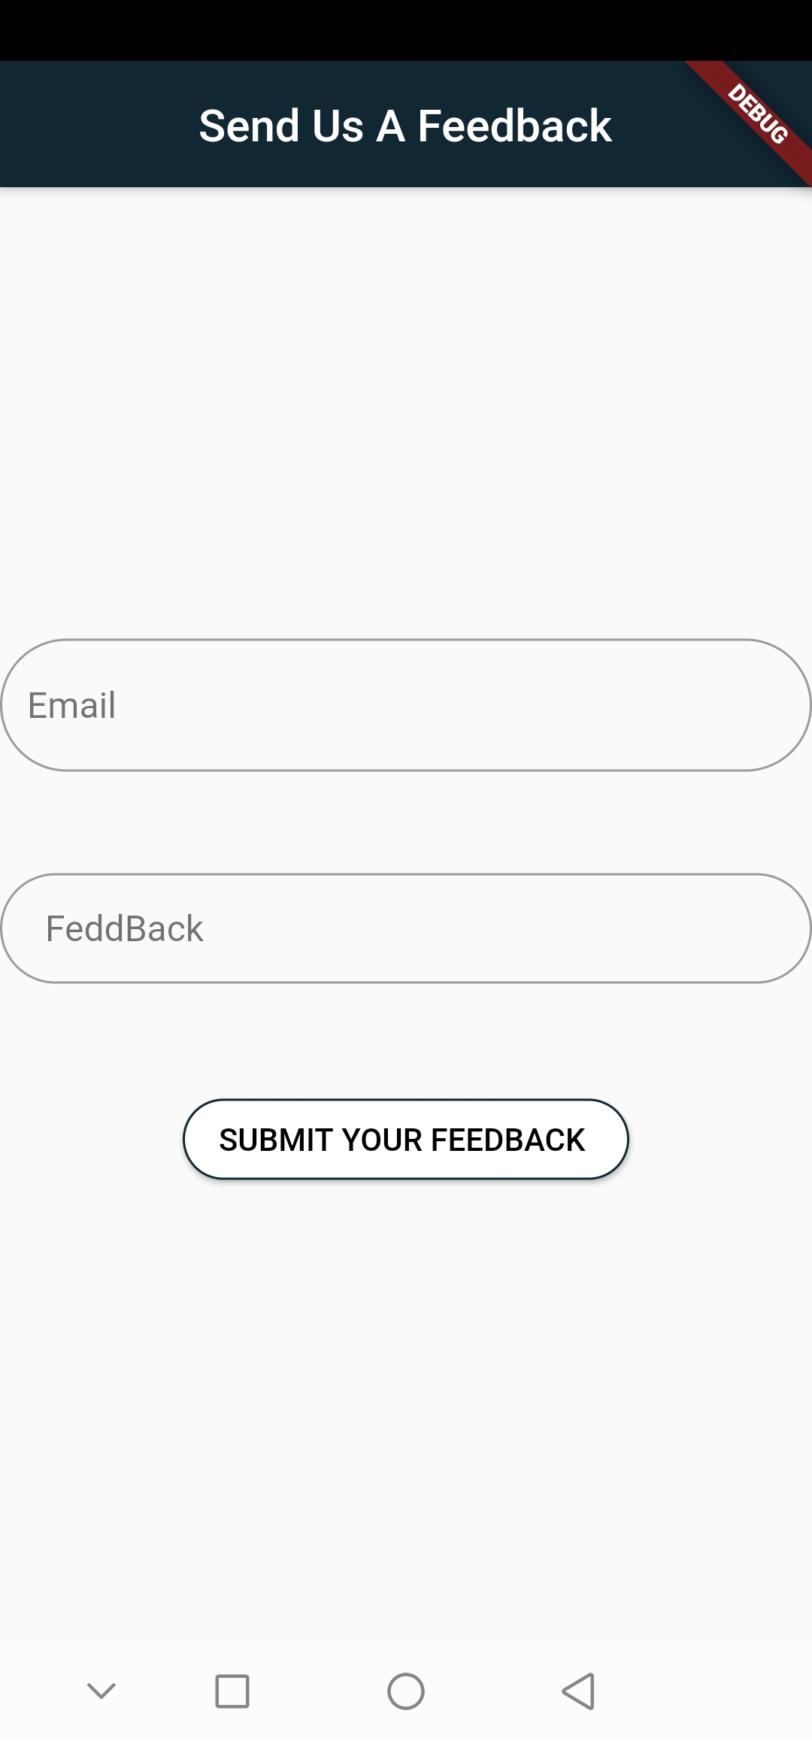
14. Some Other functions in the app.
The user can share the app (link of the app in play store).
The user can submit a feedback for the app if he want.

Slide 23
Thank you for Listening ☺

